Slide 1
Project 1, Module 5
Lucas Ross

Slide 2

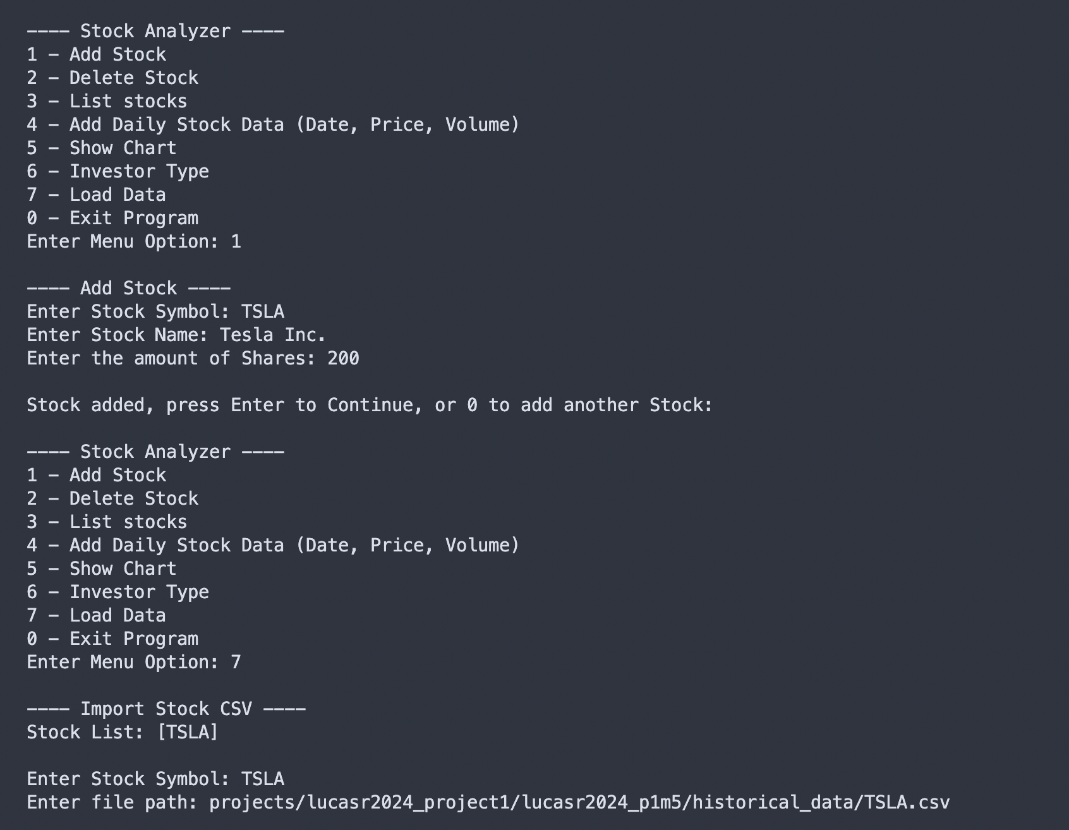
Stock Initialization
One stock, Tesla Inc. [TSLA] (200 shares), is created
The records are accessed from an imported CSV file (TSLA.csv) from Yahoo Finance.

Slide 3
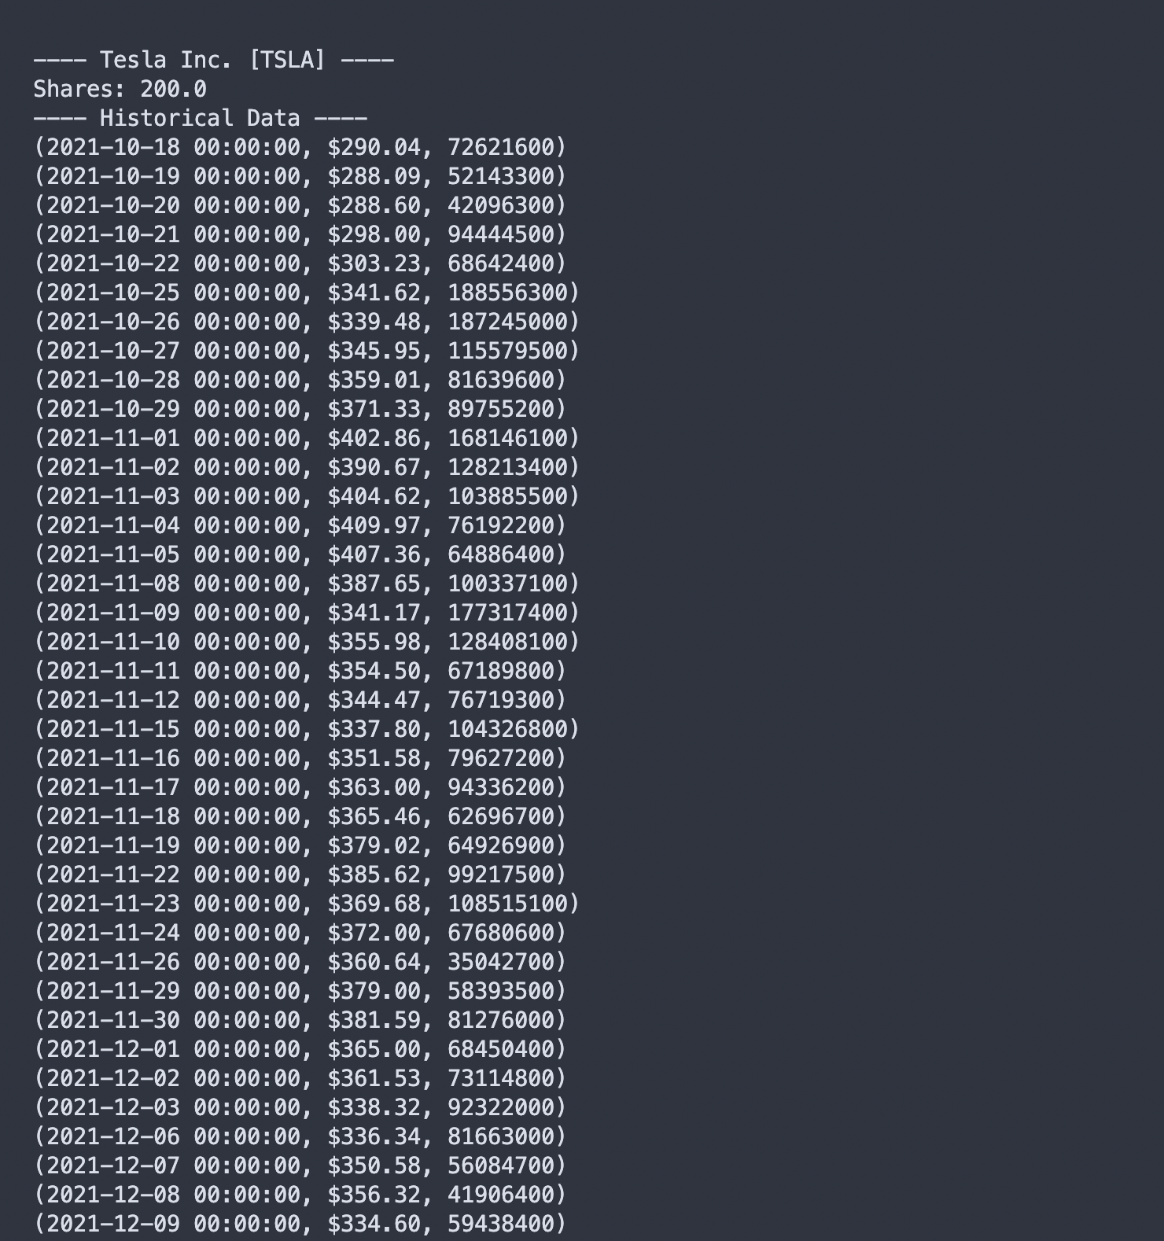
Stock Display (Historical Data)
The company name, ticker symbol, and amount of shares of the stock are listed.
Every DailyData object from the imported CSV file is listed (not all records are shown).

Slide 4
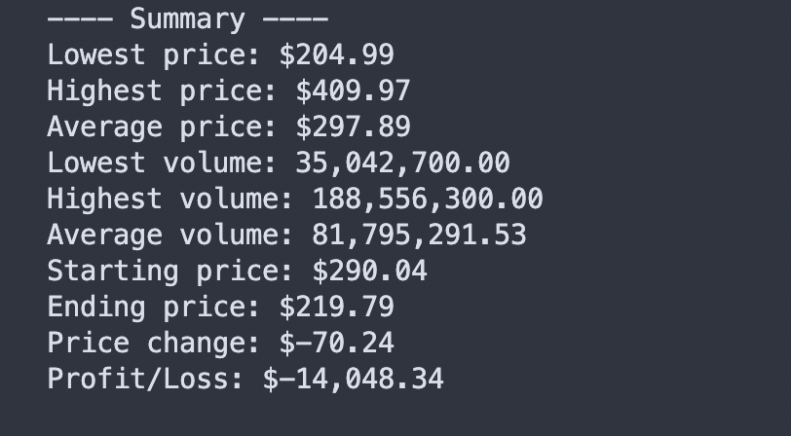
Stock Display (Summary)
Metrics relating to the closing price and volume of the stock over time are calculated and listed below.
The metrics are based on data from the imported CSV file.

